Slide 1




Reddit Classifier Android vs Apple
DSIF 5 Loh Wei Hao

Slide 2


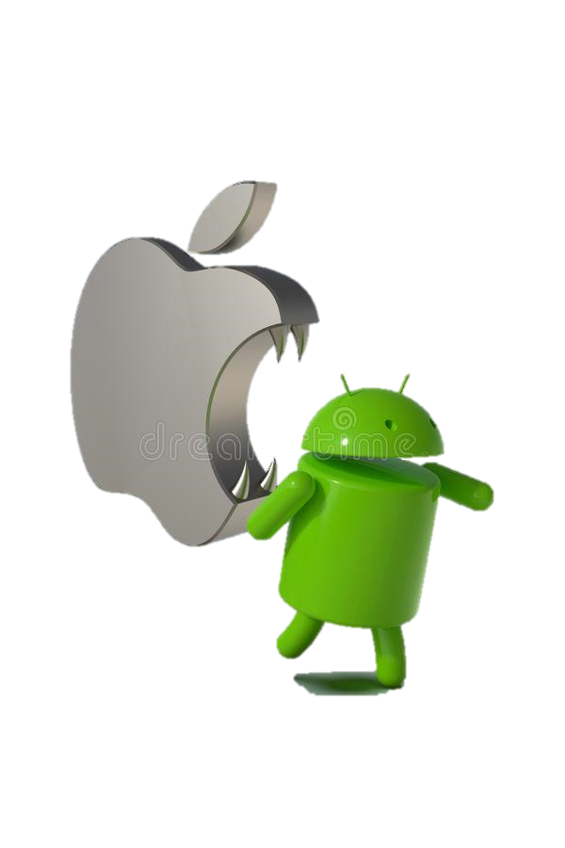
Project analysis slide 3
Outline
Data Extraction
Data Cleaning
EDA
Modelling
Conclusion

Slide 3


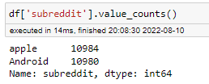

Project analysis slide 4
Data Gathering
Collected 11,000 post from each sub

Slide 4


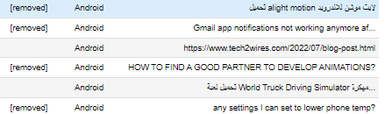
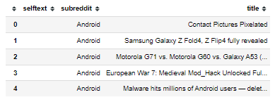


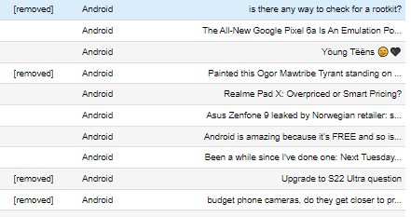
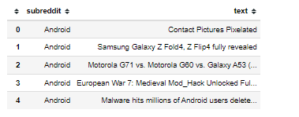
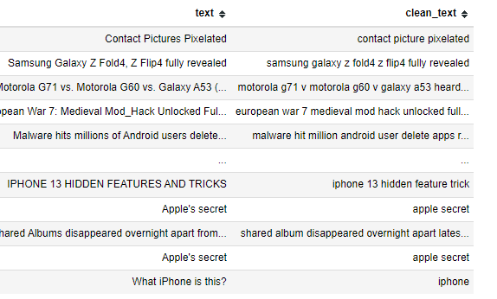

Project analysis slide 4
Data Cleaning
Replaced [removed], [deleted] & NaN with Empty strings
Removed non-ASCII text
Combined selftext + title column
Applied Lemmatizer

Slide 5
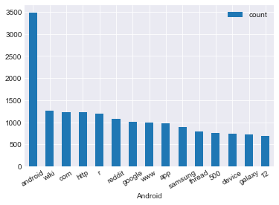
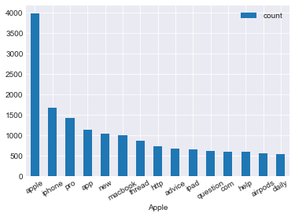

Project analysis slide 5
EDA
Common Words
Android Word count
Apple Word count
‘app’, ‘http’
102847
105293
Will be adding list of common words to Stopwords.

Slide 6

Project analysis slide 4
Data Cleaning
Adding additional Stop words
Words that Occurs Frequently in both Subs may confuse the models, as such common words have been added.

Slide 7
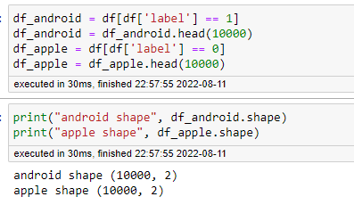
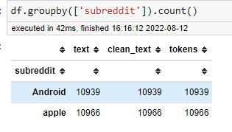
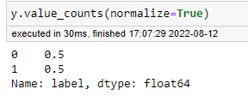

Project analysis slide 4
Data Imbalance

Slide 8
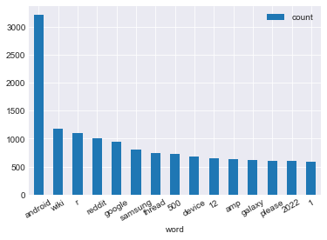
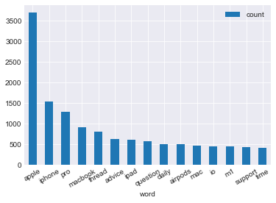
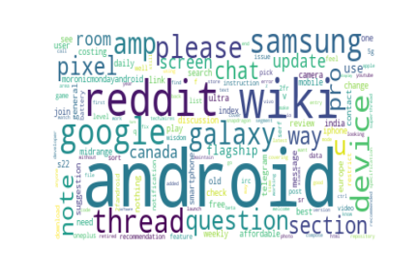
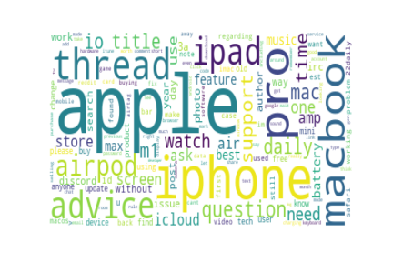

Project analysis slide 5
EDA
Android Word count
Apple Word count
92806
88505

Slide 9

Project analysis slide 6
Model
Text Data
Count Vectorizer
Tf-idf Vectorizer
Support Vector Machines
Support Vector Machines
multinomial naive bayes
Random Forest
multinomial naive bayes
Random Forest

Slide 10
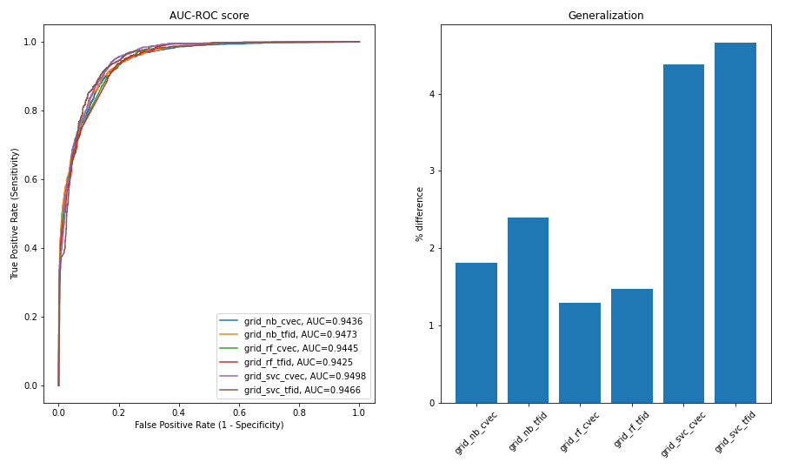
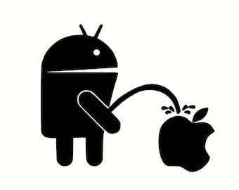
Project analysis slide 7
Model Analysis
Model | Train (auc_roc_score) | Test (auc_roc_score) | Difference %
cvec_nb | 96.12% | 94.36% | 1.83%
tfidf_nb | 97.02% | 94.73% | 2.36%
cvec_rf | 95.70% | 94.45% | 1.31%
tfid_rf | 95.55% | 94.25% | 1.36%
cvec_svm | 99.41% | 94.98% | 4.46%
tfid_svm | 99.09% | 94.66% | 4.47%
cvec_rf
AUC ROC Test Scores are very close
The Random Forest with Count Vectorizer has the best generalization among the 6 models.

Slide 11
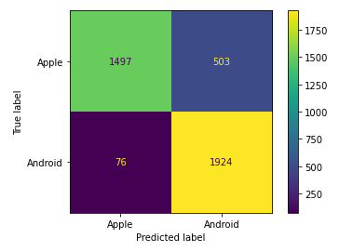
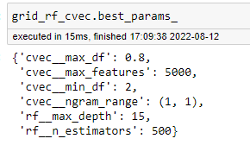

Project analysis slide 8
RF Analysis
Model predicted Apple 1573 times and 2427 times for Android
Precision score : 0.7927
Accuracy Score 0.8552
ROC-AUC score of 0.9445
error rate : 0.1448
tendency to predict android more than apple

Slide 12
Project analysis slide 10
Conclusion
Feature Importance
Model can reliably determine which Subreddit each post is from with an accuracy of 85.52%
Model can be further improved with a larger range of hyper parameter tuning.

Slide 13
Thank You

